Slide 1

Cyber Attacks Analysis
done by: Fatema Alasbahi
Date: July 30th 2024

Slide 2
Objectives
Dataset Overview
Data Prepossessing
Analysis of Attack Distribution
Analysis of Attack Types
Temporal Analysis
Future Analysis

Slide 3
DataSet overview
Source: Dataset is taken from Kaggle
Duration: The dataset records cyber attacks from January 1, 2020, to October 11, 2023.
Shape: The records cover 40,000 data entries and include 25 different columns.

Slide 4

Data Prepossessing
Ensuring Data Quality for Accurate Analysis and Insights

Slide 5
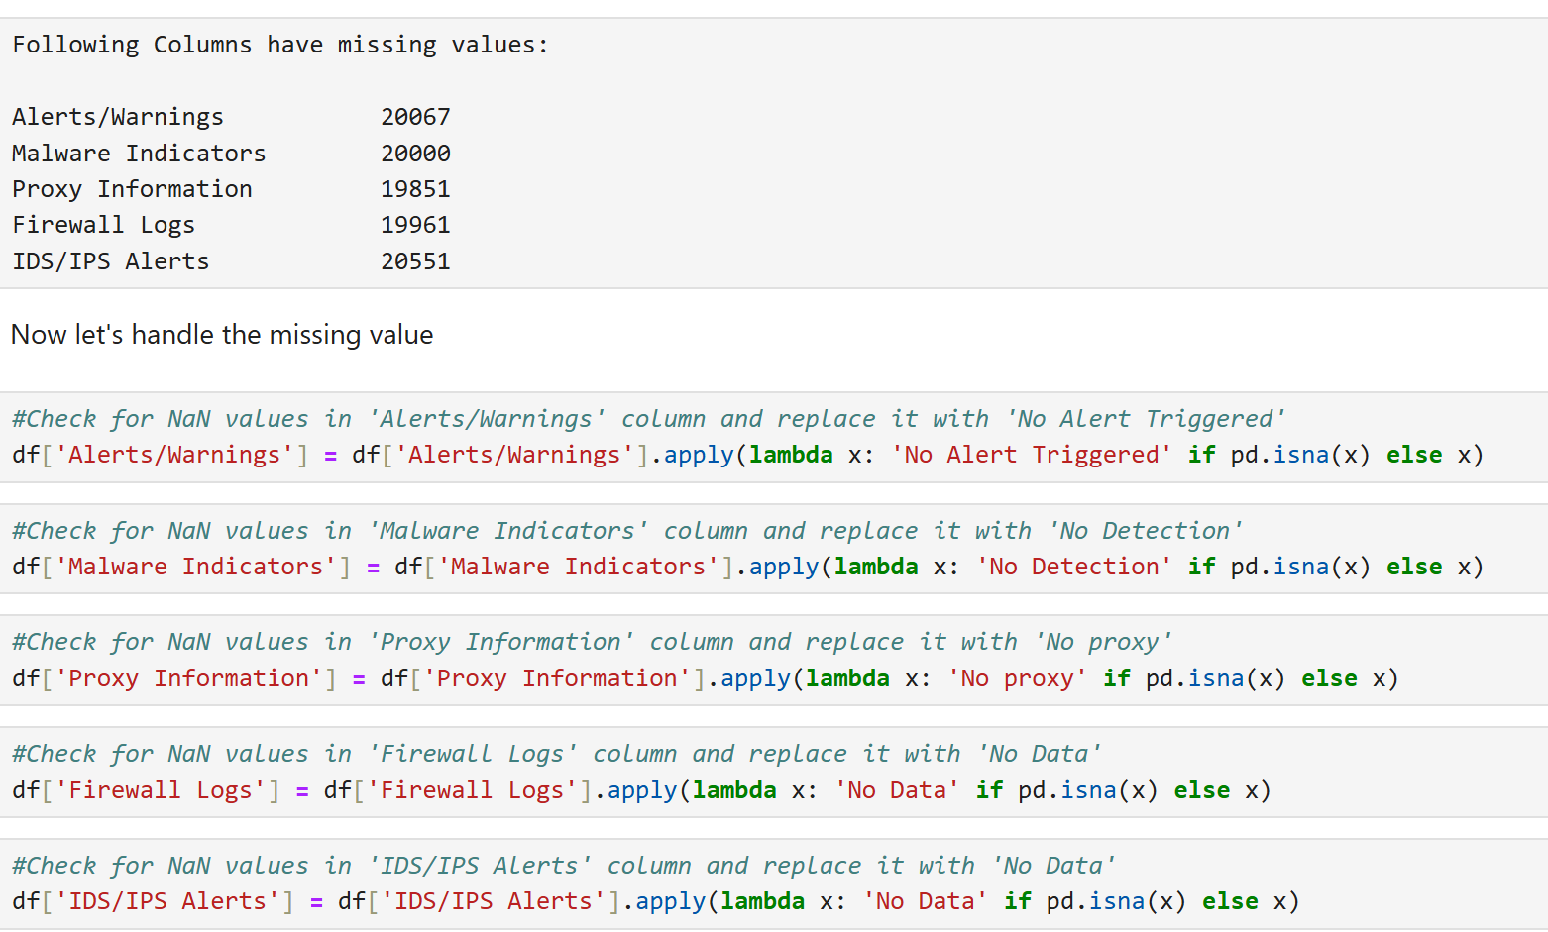
Data Prepossessing
Data preprocessing involves cleaning and transforming raw data into a usable format for analysis.
It enhances data quality, ensuring accurate and meaningful and complete analysis.

Slide 6

Analysis of Attack Distribution

Slide 7
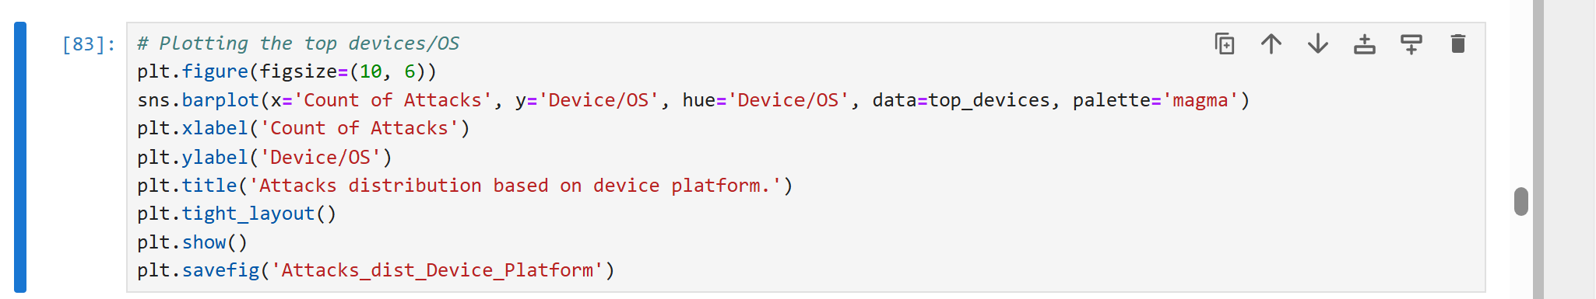
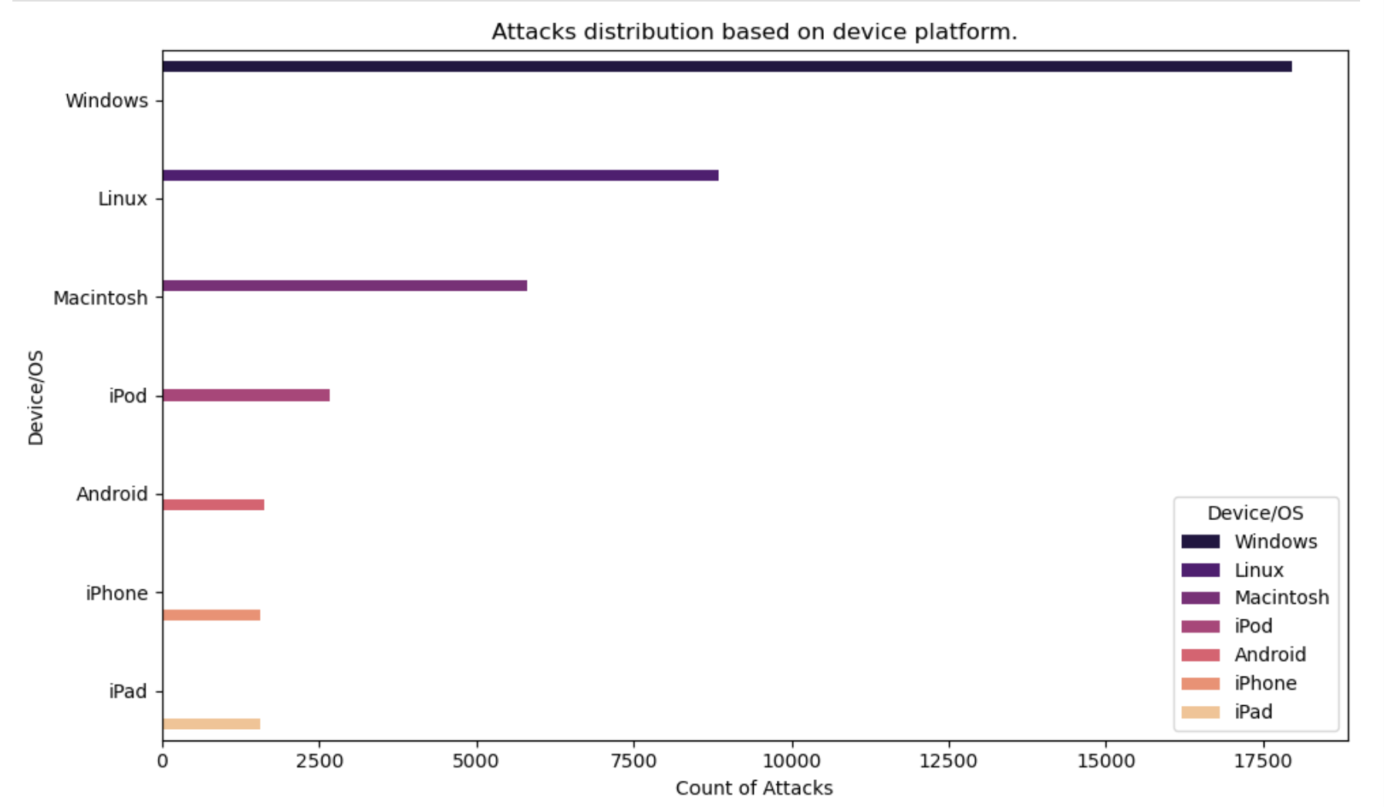

Attacks distribution
Based on device platform.
A plot of attack distribution by device type visually represents the frequency or proportion of cybersecurity attacks targeting various device categories.
This analysis helps in identifying which types of devices are most susceptible to attacks, enabling better allocation of security resources.
The plot reveals that Windows and Linux devices are most frequently attacked, this outcome will lead to the development of targeted security strategies and preventive measures.
Notes:
Speaker notes:
The focus for this activity is:
Introduce the Microsoft 365 Compliance vision.
Outline Microsoft’s approach to providing integrated compliance. .

Slide 8

Analysis of Attack Types

Slide 9
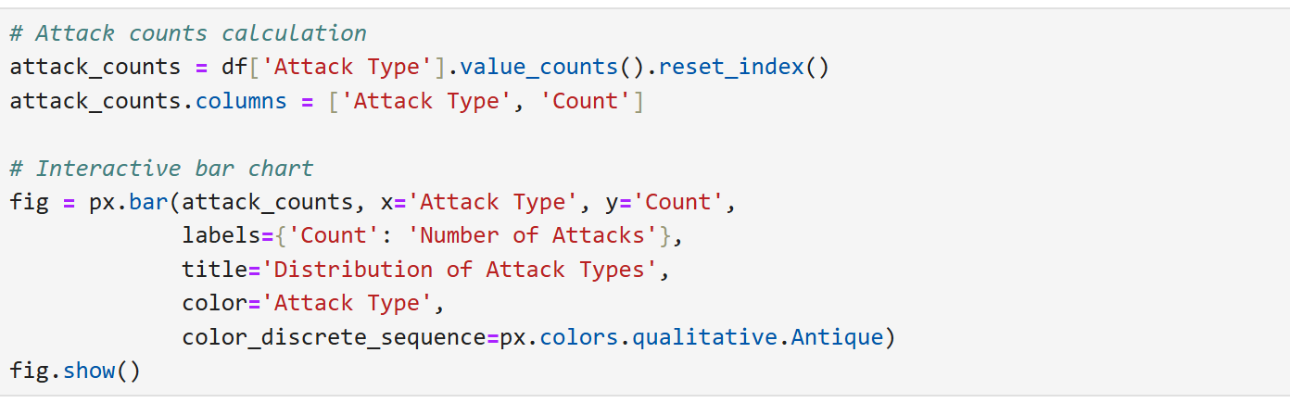
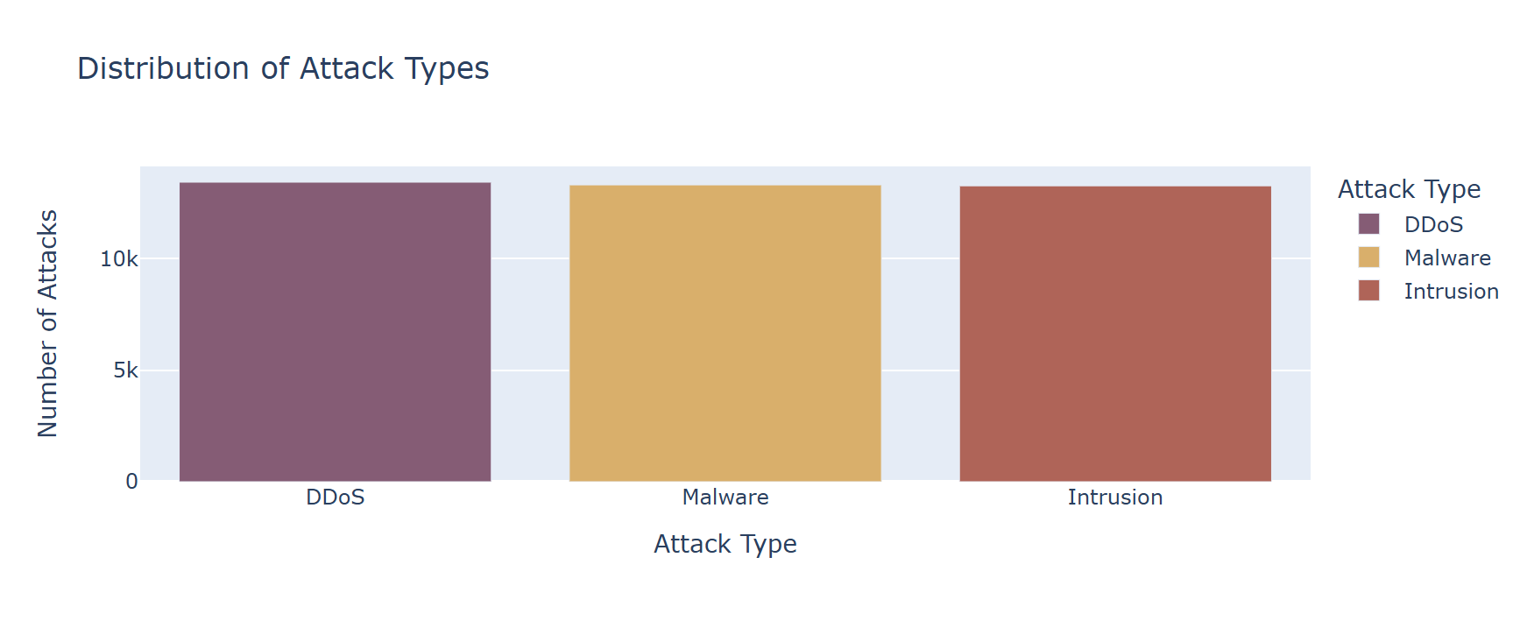
Attacks Type Analysis
The attack type analysis plot visualizes the frequency and distribution of different cyberattack types, such as malware, DDoS, and intrusion.
This analysis helps identify prevalent threats, enabling better resource allocation for cybersecurity measures.
The analysis reveals that DDoS attacks are the most common, highlighting the need for robust defense mechanisms against this type of threat.
Notes:
Speaker notes:
The focus for this activity is:
Introduce the Microsoft 365 Compliance vision.
Outline Microsoft’s approach to providing integrated compliance. .

Slide 10
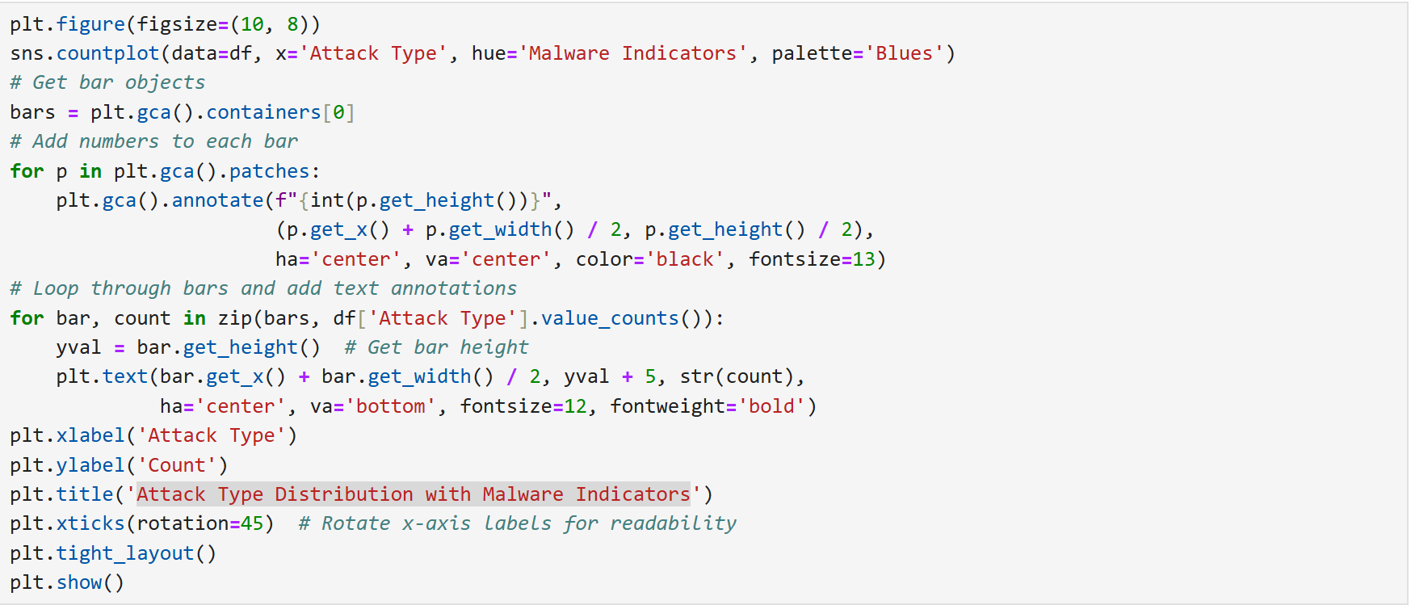
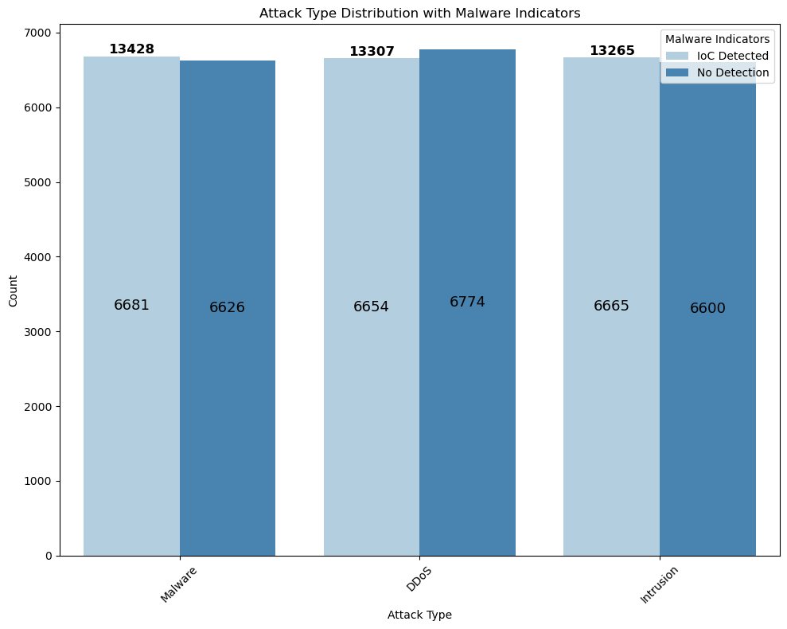
Attack Type Distribution
with Malware Indicators
The "Attack Type Distribution with Malware Indicators" plot visualizes the frequency of different attack types alongside associated malware indicators.
This analysis helps identify patterns and correlations between specific attack types and the presence of malware, aiding in targeted security measures.
The plot reveals insights into which attack types are most linked with malware, informing more effective detection and response strategies..
Notes:
Speaker notes:
The focus for this activity is:
Introduce the Microsoft 365 Compliance vision.
Outline Microsoft’s approach to providing integrated compliance. .

Slide 11
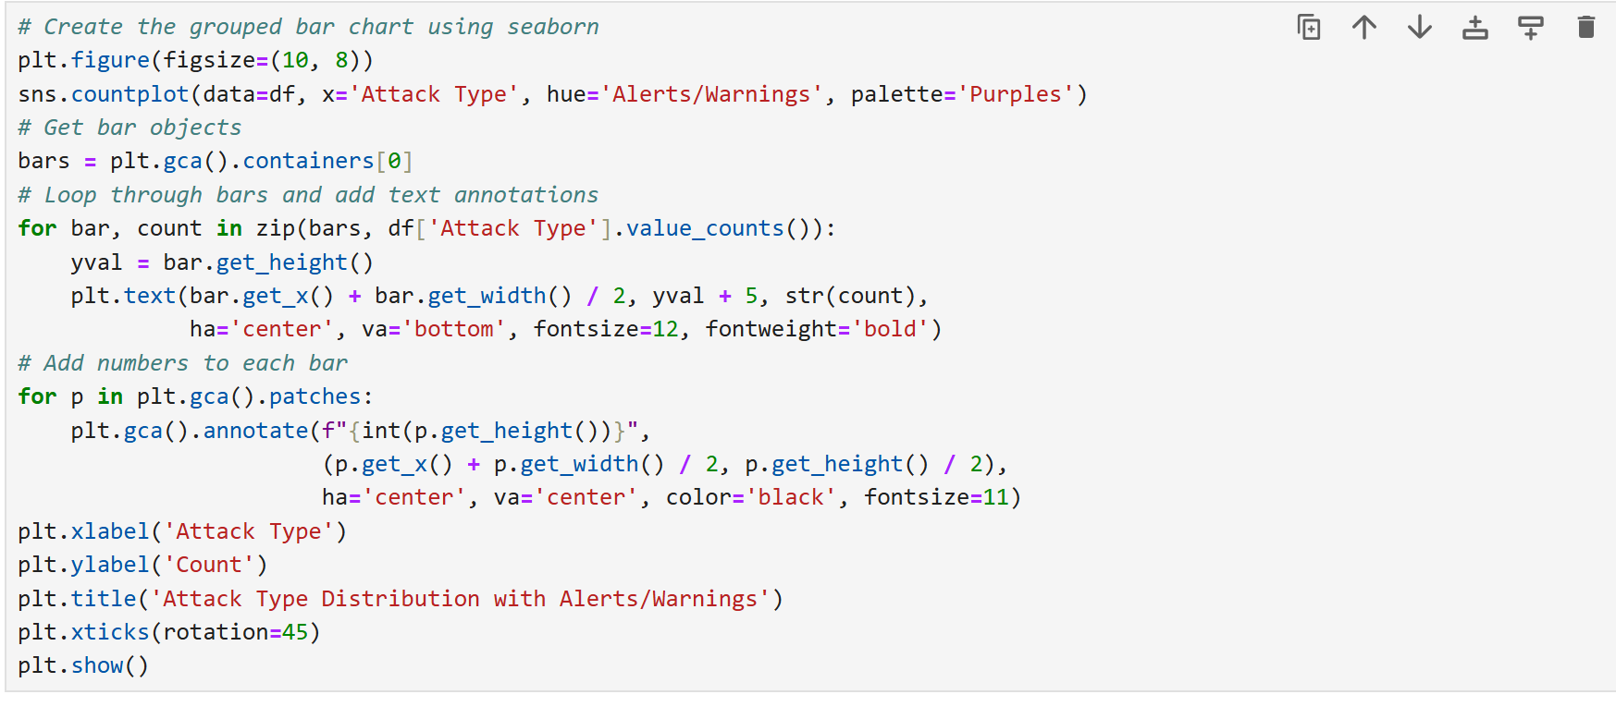
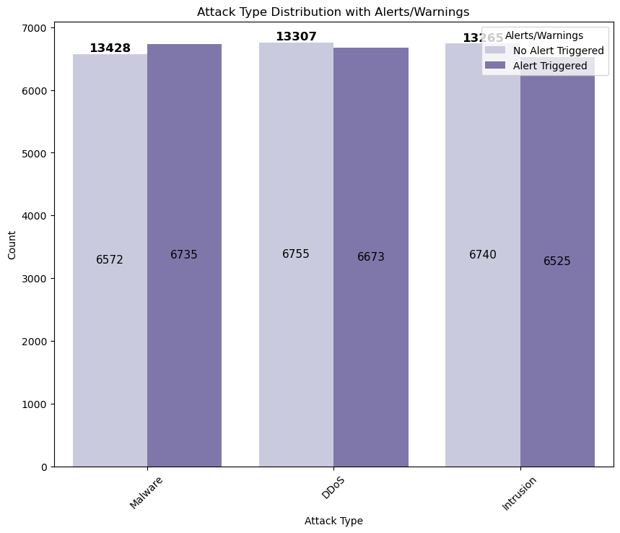
Attack Type Distribution
with Alerts/Warnings
This plot shows the distribution of different attack types alongside the alerts and warnings triggered.
This analysis helps in identifying which attack types frequently trigger alerts, aiding in refining security response strategies.
The plot reveals correlations between specific attack types and alert mechanisms, guiding improvements in monitoring systems.
Notes:
Speaker notes:
The focus for this activity is:
Introduce the Microsoft 365 Compliance vision.
Outline Microsoft’s approach to providing integrated compliance. .

Slide 12
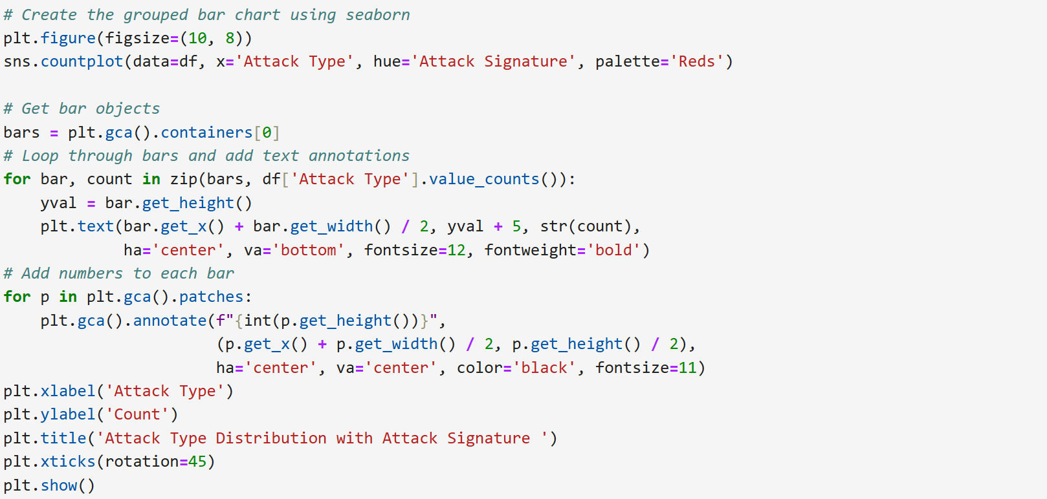
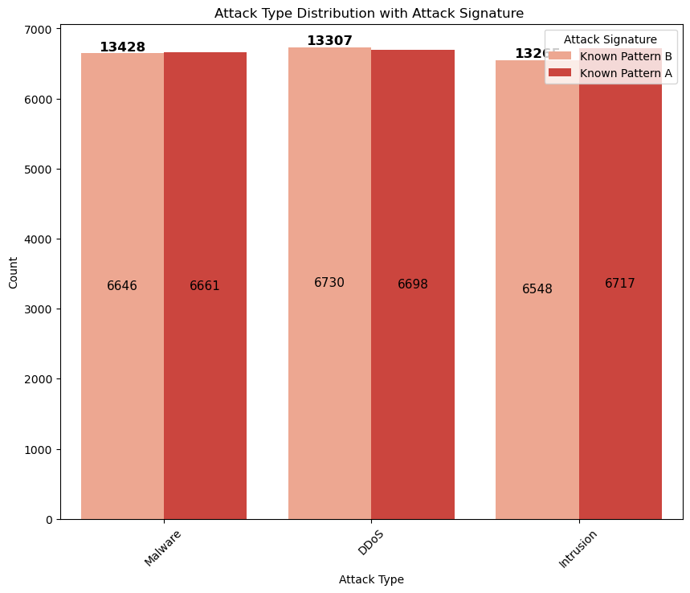
Attack Type Distribution
with Attack Signature
The plot categorizes the frequency of various attack types based on their associated signatures, such as "Known Pattern A" and "Known Pattern B.".
This analysis helps in distinguishing between different attack patterns, enabling more targeted threat detection and mitigation strategies.
The plot reveals which attack types are most associated with each pattern, providing insights into the prevalence and characteristics of different threats.
Notes:
Speaker notes:
The focus for this activity is:
Introduce the Microsoft 365 Compliance vision.
Outline Microsoft’s approach to providing integrated compliance. .

Slide 13
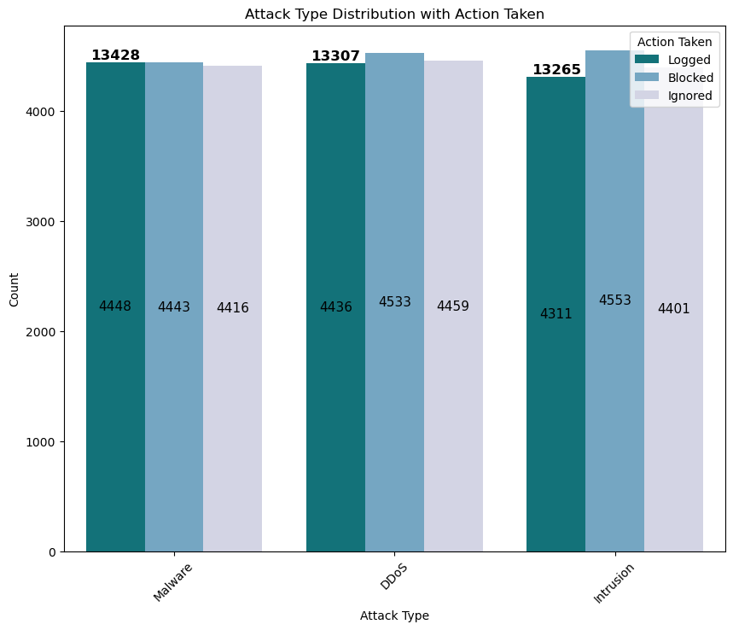
Attack Type Distribution
with Action Taken.
The plot visualizes the frequency of different cybersecurity attack types and the actions taken in response, such as logging, blocking, or ignoring.
This analysis helps in understanding the effectiveness and prevalence of response strategies for various attack types
The plot reveals which attack types are most common and how often they are logged, blocked, or ignored, providing insights into response patterns and areas for improvement..
Notes:
Speaker notes:
The focus for this activity is:
Introduce the Microsoft 365 Compliance vision.
Outline Microsoft’s approach to providing integrated compliance. .

Slide 14

Temporal Analysis
Using Timestamp Column

Slide 15
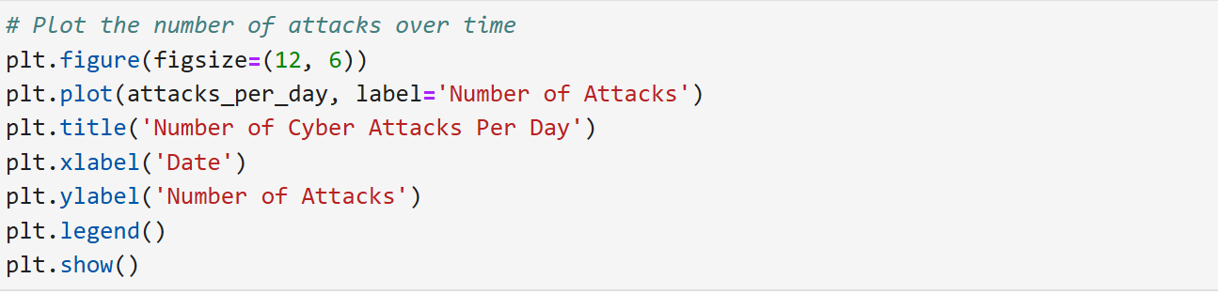
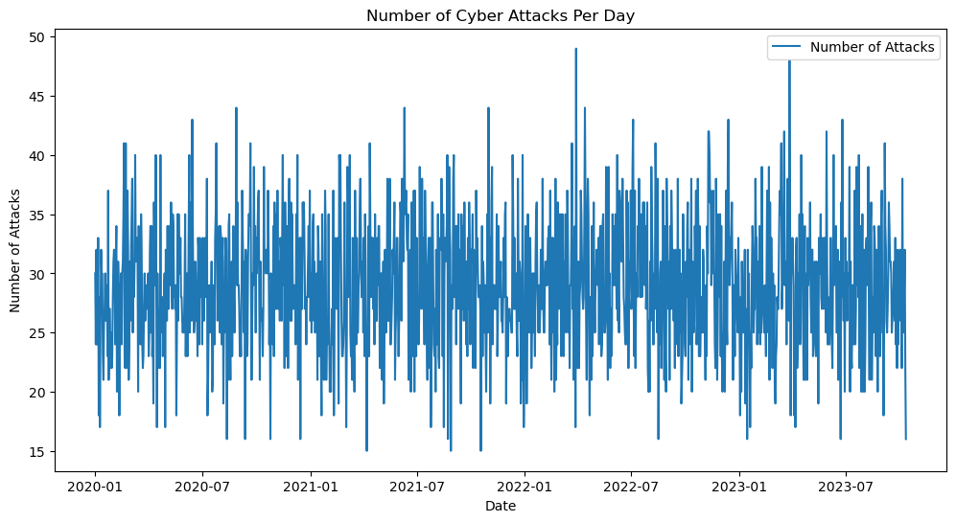
Number of Cyber Attacks
Per Day.
The "Number of Cyber Attacks Per Day" plot visualizes the frequency of cyber attacks over a specified period.
This analysis helps identify trends and patterns in attack occurrences, aiding in proactive threat management.
The plot reveals peak periods of activity, guiding resource allocation and enhancing readiness during high-risk times.
Notes:
Speaker notes:
The focus for this activity is:
Introduce the Microsoft 365 Compliance vision.
Outline Microsoft’s approach to providing integrated compliance. .

Slide 16
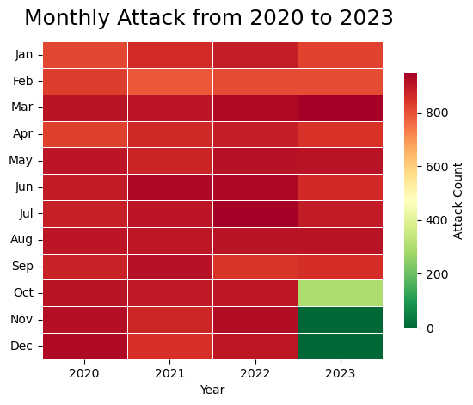
Monthly Attack from
2020 to 2023.
A monthly attack heatmap visually represents the frequency of cyber attacks over time, with a focus on monthly trends from 2020 to 2023.
This analysis helps in highlighting temporal patterns in cyber attacks, helping identify periods of heightened activity.
The heatmap reveals seasonal trends and anomalies, guiding strategic planning and resource allocation for cybersecurity efforts.
Notes:
Speaker notes:
The focus for this activity is:
Introduce the Microsoft 365 Compliance vision.
Outline Microsoft’s approach to providing integrated compliance. .

Slide 17
Future Analysis
Using Machine Learning
Add more columns to the analysis

Slide 18
Thank you for listening
Q&A

